Slide 1

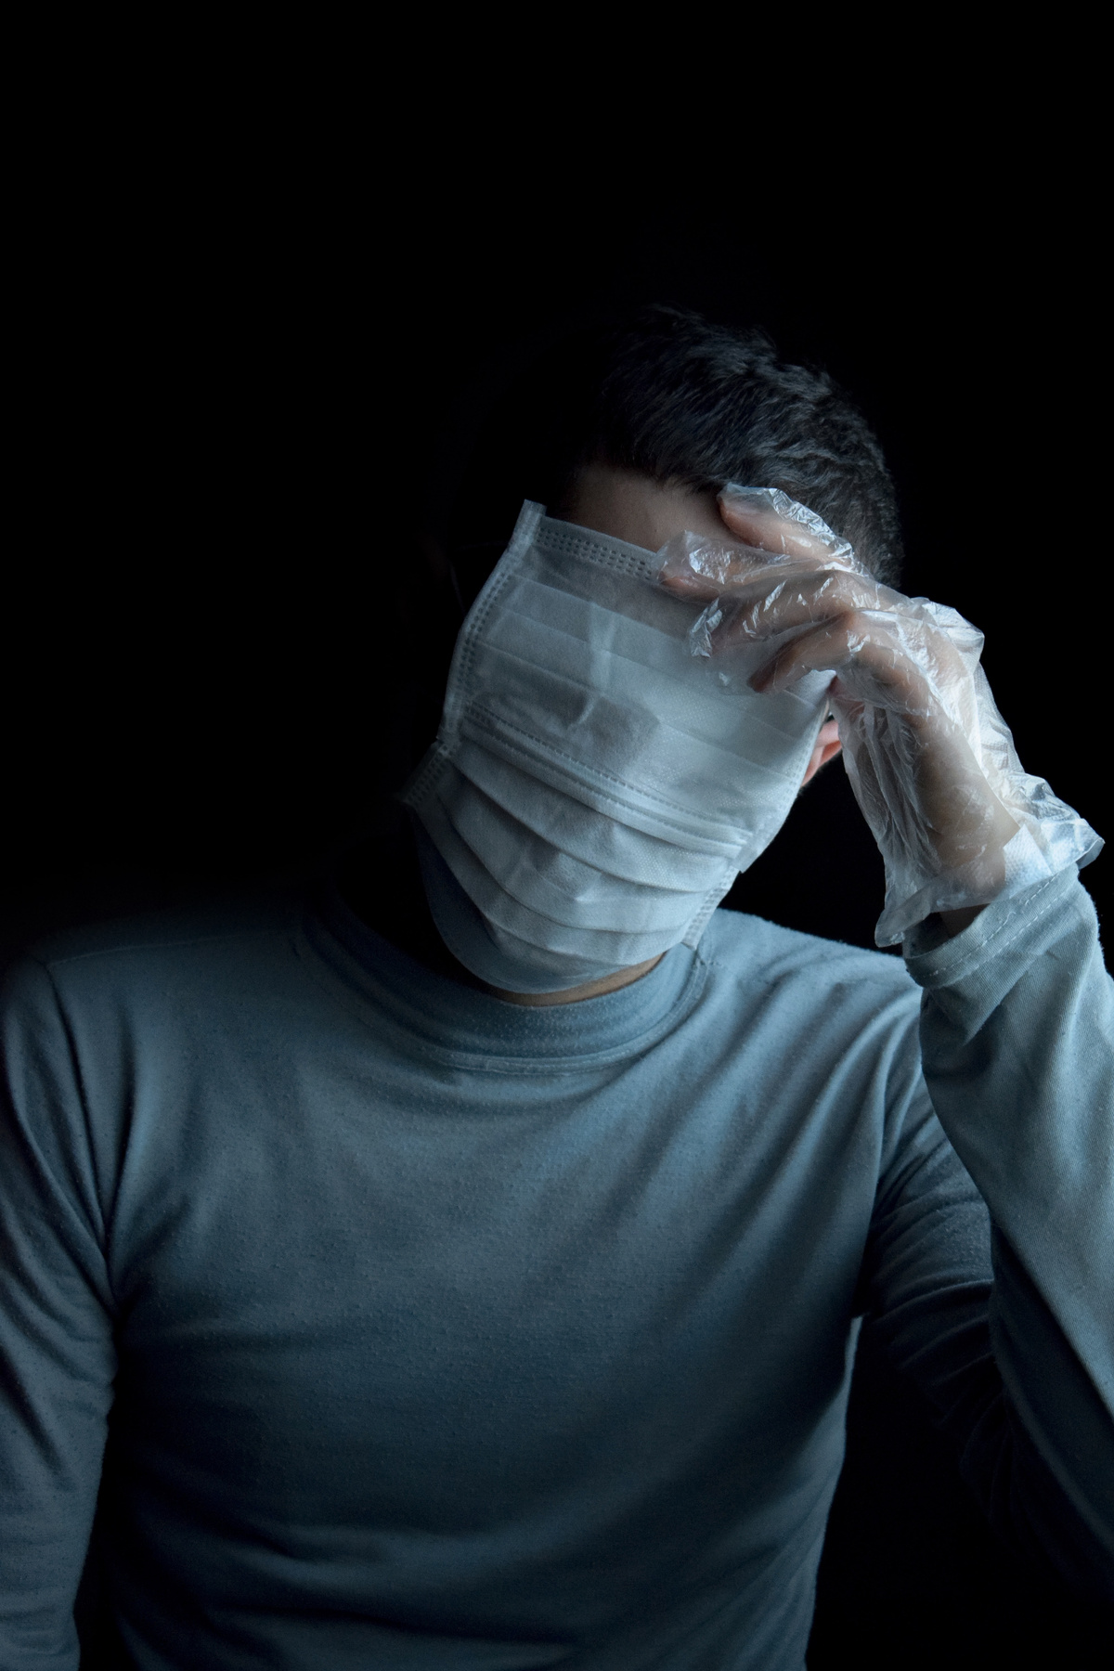
DEFEATING
Dealing with COVID-19 health care industry
COVID-19
CSI HACKATHON
DEFEATING COVID-19

Slide 2
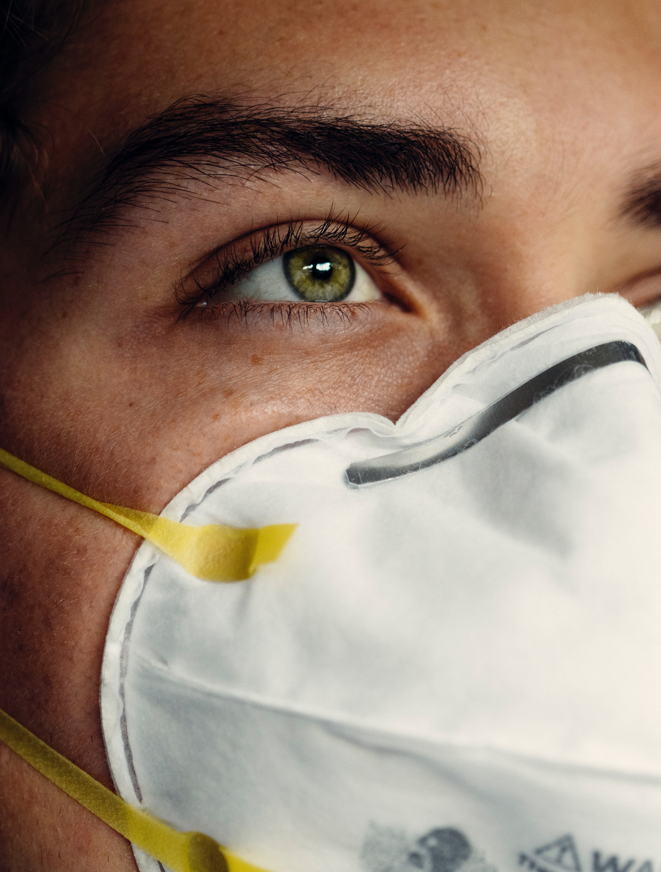


Main Highlights of the Hack
Live bed count data
Plasma doner-receiver portal
Help people find covid medical resources
Personal experiences
MAIN HIGHLIGHTS
DEFEATING COVID-19

Slide 3

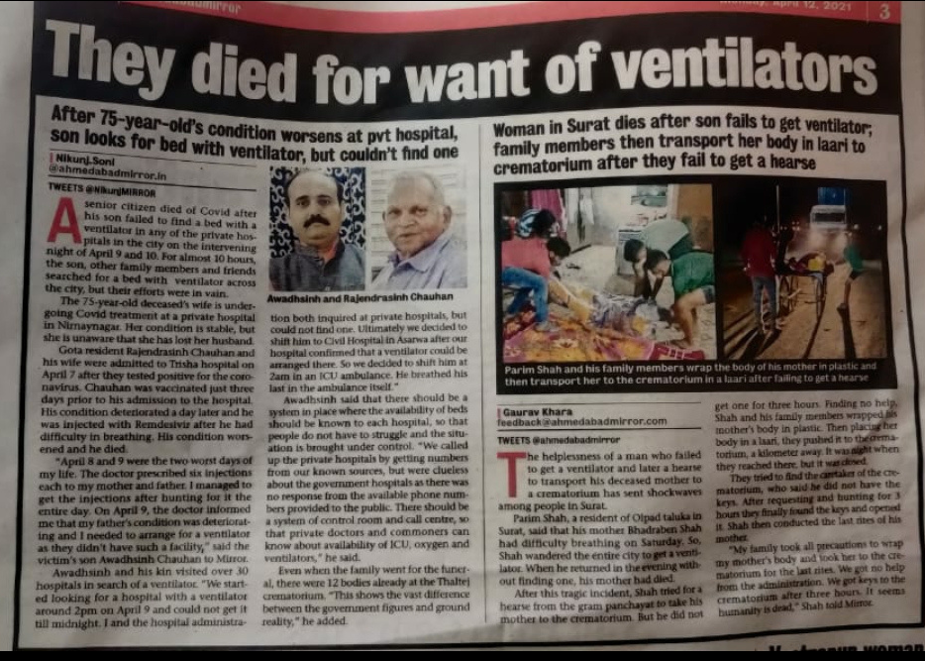

NEED FOR A PROPER BED COUNT SYSTEM
This is only one case out of who knows how many.
Can you consider their death due to Covid or because of inefficient sytem?
DEFEATING COVID-19

Slide 4

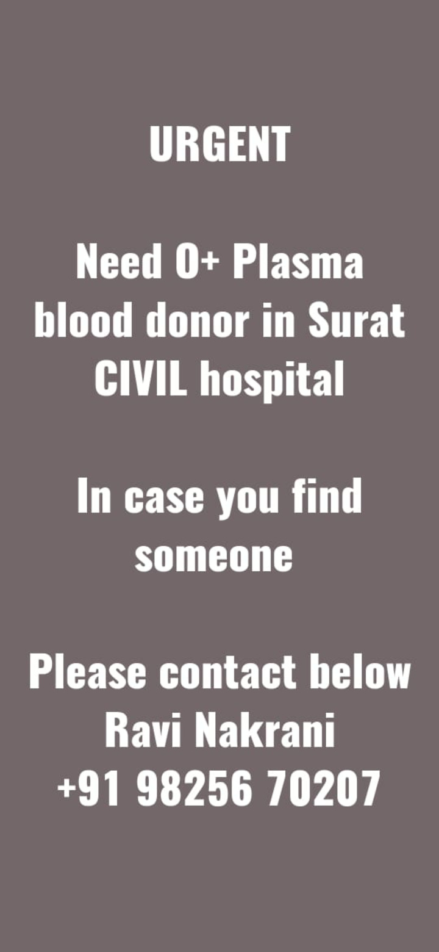
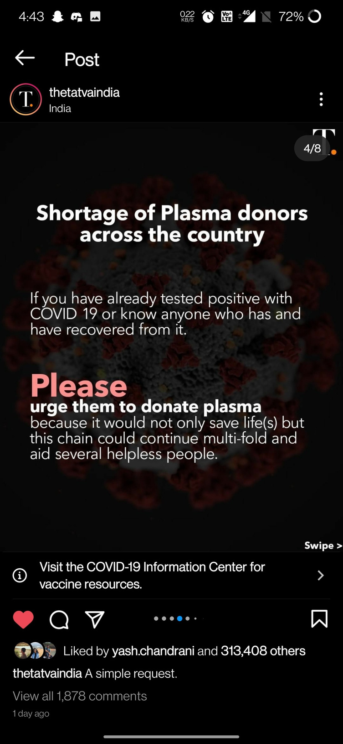
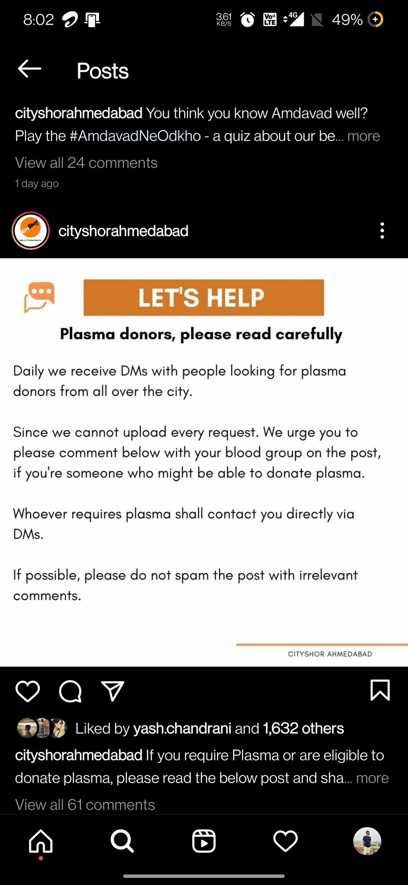
NEED FOR PLASMA DONOR
DEFEATING COVID-19

Slide 5



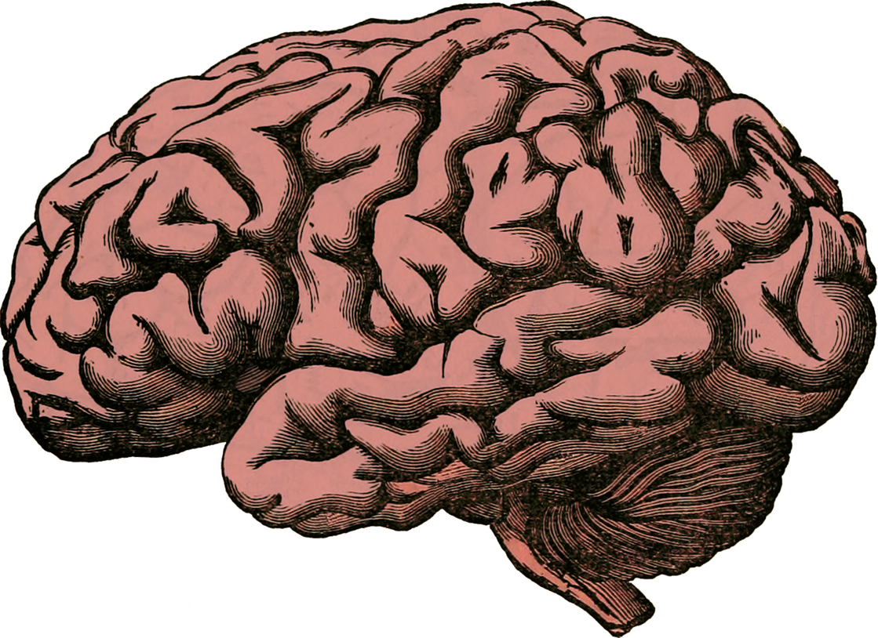
THE MINDSET
People don't abide by the night curfew.
People don't wear masks.
Many people think Covid is a myth.

Slide 6

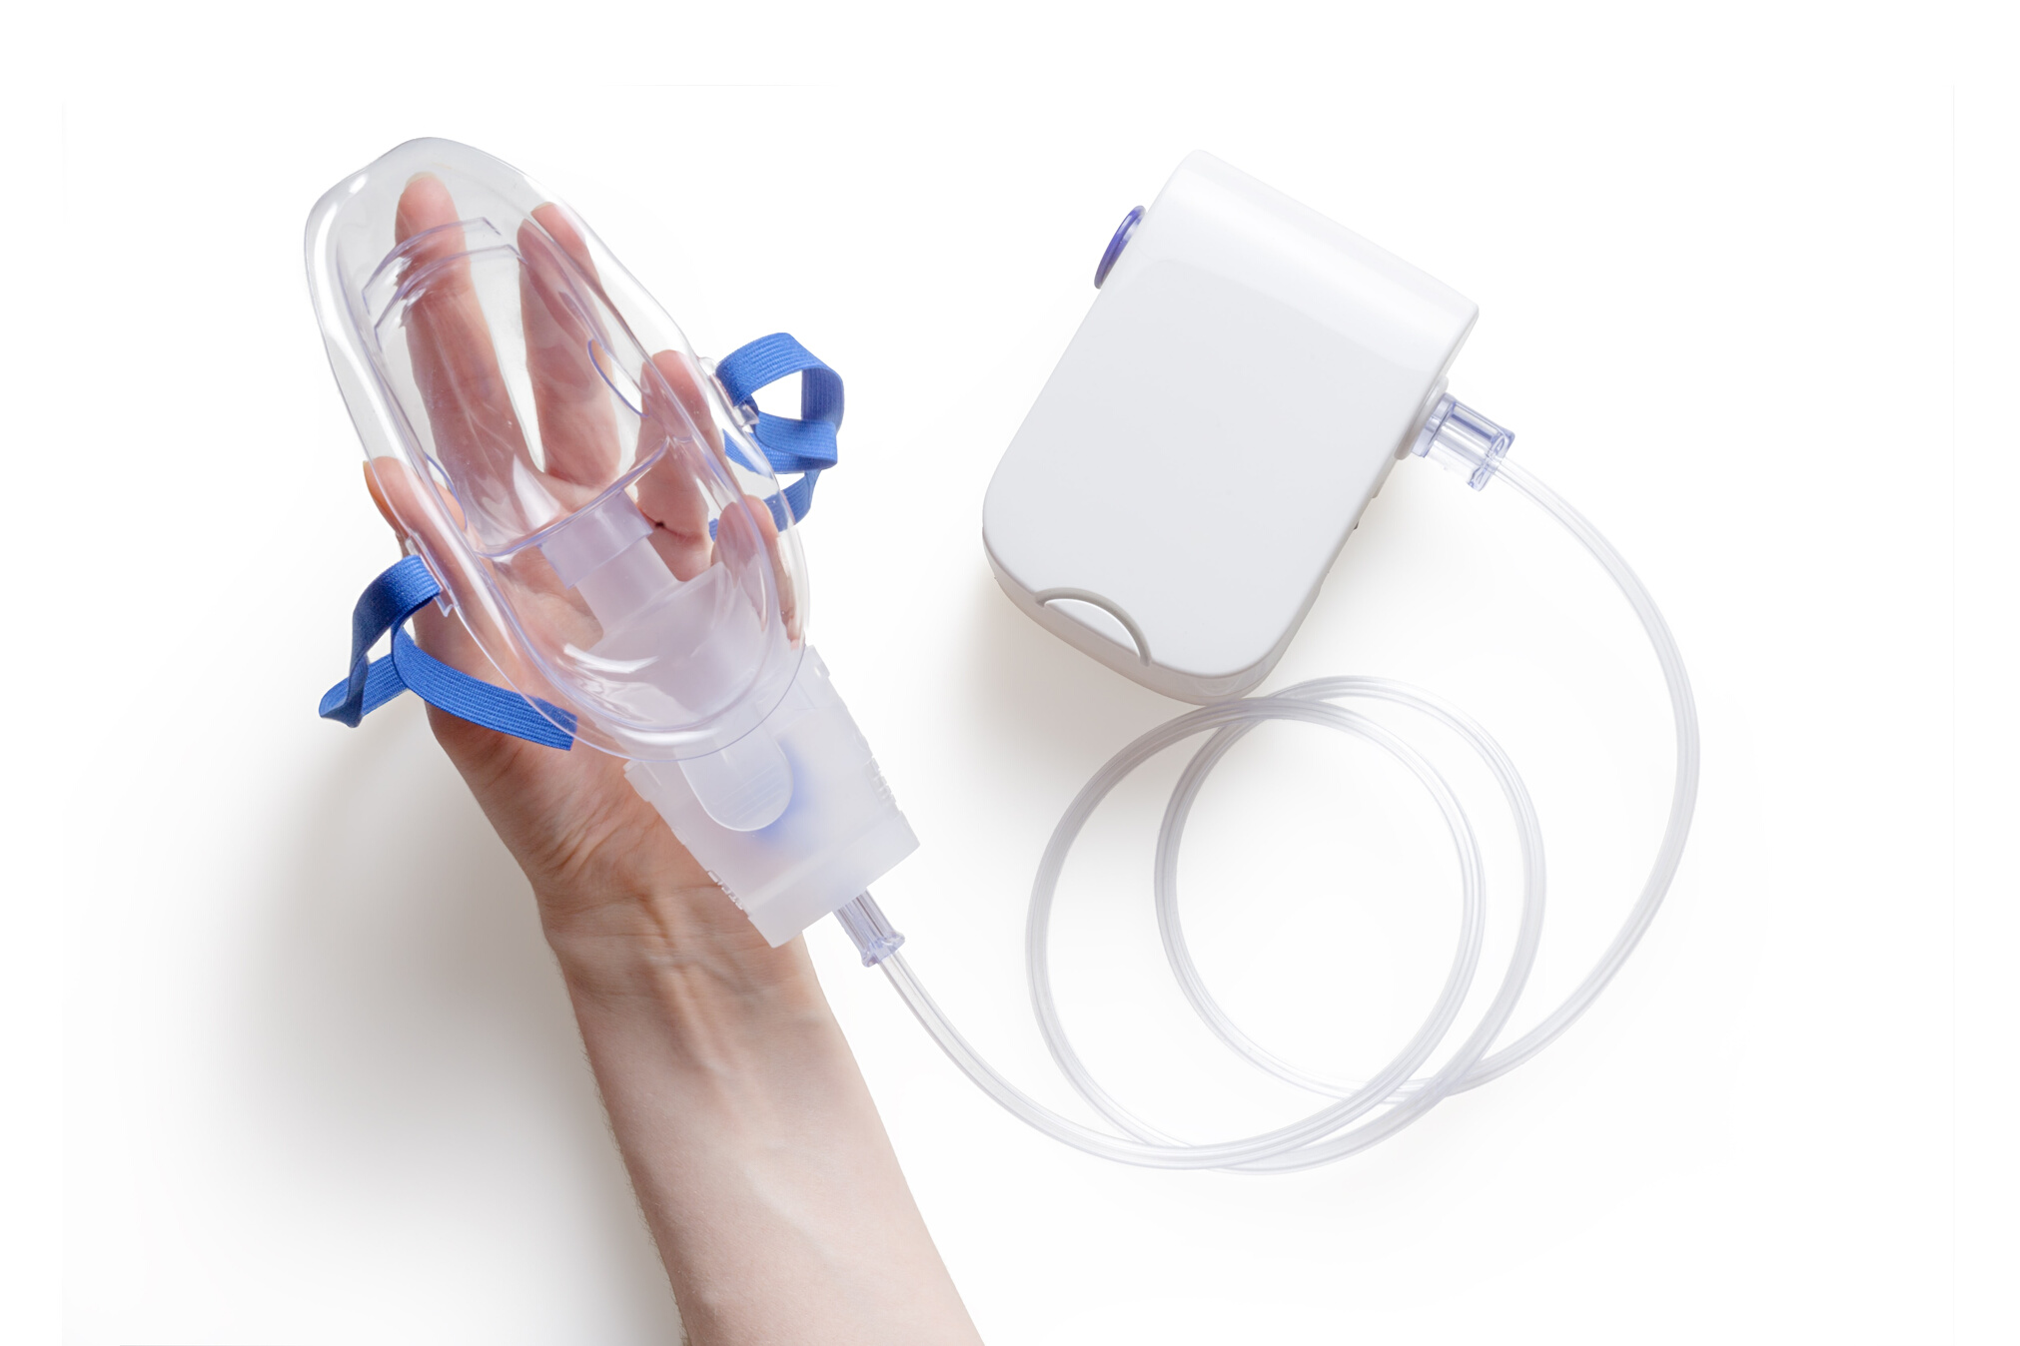

COVID RESOURCES AVAILABILITY
O2 CONCENTRATORS
HFNC
BiPAP
O2 CYLINDERS
OTHERS
INCREASE SALES AND COMPETITION DECREASE PRICE
DEFEATING COVID-19

Slide 7



Ctrl+Alt+Del
Raj Madhu
Mitansh Gor
Yash Chandrani
THANK YOU
DEFEATING COVID-19

